Slide 1
DEEP LEARNING APPLICATIONS IN MEDICAL IMAGE ANALYSIS-BRAIN TUMOR

Slide 2
Abstract
The tremendous success of machine learning algorithms at image recognition tasks in recent years intersects with a time of dramatically increased use of electronic medical records and diagnostic imaging. This review introduces the machine learning algorithms as applied to medical image analysis, focusing on convolutional neural networks, and emphasizing clinical aspects of the _eld. The advantage of machine learning in an era of medical big data is that signi_cant hierarchal relationships within the data can be discovered algorithmically without laborious hand-crafting of features. We cover key research areas and applications of medical image classi_cation, localization, detection, segmentation, and registration. We conclude by discussing research obstacles, emerging trends, and possible future directions

Slide 3
Introduction
Machine learning algorithms have the potential to be invested deeply in all _elds of medicine, from drug discovery to clinical decision making, signi_cantly altering the way medicine is practiced. The success of machine learning algorithms at computer vision tasks in recent years comes at an opportune time when medical records are increasingly digitalized. The use of electronic health records (EHR) quadrupled from 11.8% to 39.6% amongst of_ce-based physicians in the US from 2007 to 2012 [1]. Medical images are an integral part of a patient's EHR and are currently analyzed by human radiologists, who are limited by speed, fatigue, and experience. It takes years and great _nancial cost to train a quali_ed radiologist, and some health-care systems outsource radiology reporting to lower-cost countries such as India via tele-radiology. A delayed or erroneous diagnosis causes harm to the patient. Therefore, it is ideal for medical image analysis to be carried out by an automated, accurate and ef_cient machine learning algorithm.

Slide 4
EXISTING SYSTEM
There is a myriad of imaging modalities, and the frequency of their use is increasing. Smith-Bindman et al. [2] looked at imaging use from 1996 to 2010 across six large integrated healthcare systems in the United States, involving 30.9 million imaging examinations. The authors found that over the study period, CT, MRI and PET usage increased 7.8%, 10% and 57% respectively.

Slide 5
…Contineous
The symbolic AI paradigm of the 1970s led to the development of rule-based, expert systems. One early implementation in medicine was the MYCIN system by Shortliffe [3], which suggested different regimes of antibiotic therapies for patients. Parallel to these developments, AI algorithms moved from heuristics-based techniques to manual, handcrafted feature extraction techniques. and then to supervised learning techniques. Unsupervised machine learning methods are also being researched, but the majority of the algorithms from 2015-2017 in the published literature have employed supervised learning methods,

Slide 6
PROPOSED SYSTEM:
CNNs are the most researched machine learning algorithms in medical image analysis [4]. The reason for this is that CNNs preserve spatial relationships when _ltering input images. As mentioned, spatial relationships are of crucial importance in radiology, for example, in how the edge of a bone joins with muscle, or where normal lung tissue interfaces with cancerous tissue.., a CNN takes an input image of raw pixels, and transforms it via Convolutional Layers, Recti_ed Linear Unit (RELU) Layers and Pooling Layers. This feeds into a _nal Fully Connected Layer which assigns class scores or probabilities, thus classifying the input into the class with the highest probability.

Slide 7
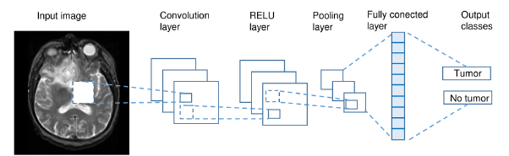
System Architecture

Slide 8
Modules
Upload MRI image
Using this module we are uploading MRI train images and then application read all images and convert them grey format.

Slide 9
Ostu Thresholding
Using this module we will apply OSTU thresholding technique on each image to extract features.

Slide 10
Generate Train & Test Model
Using this module we will build array of pixels with all images features and then split dataset into train and test model to calculate accuracy using test images by applying train model on it.

Slide 11
Generate Deep Learning CNN Model
Using this module will input train and test data to auto stack CNN model to build training classifier.

Slide 12
Get DriveHQ Images
Using this module we will read test image from DriveHQ website and then application will apply CNN classifier model on that test image to predict whether image contains tumour disease or not.

Slide 13
SOFTWARE REQUIREMENTS:
OS : Windows
Python IDE : Python 3.7.0

Slide 14
HARDWARE REQUIREMENTS
RAM : 4GB and Higher
Processor : Intel i3 and above
Hard Disk : 500GB: Minimum

Slide 15
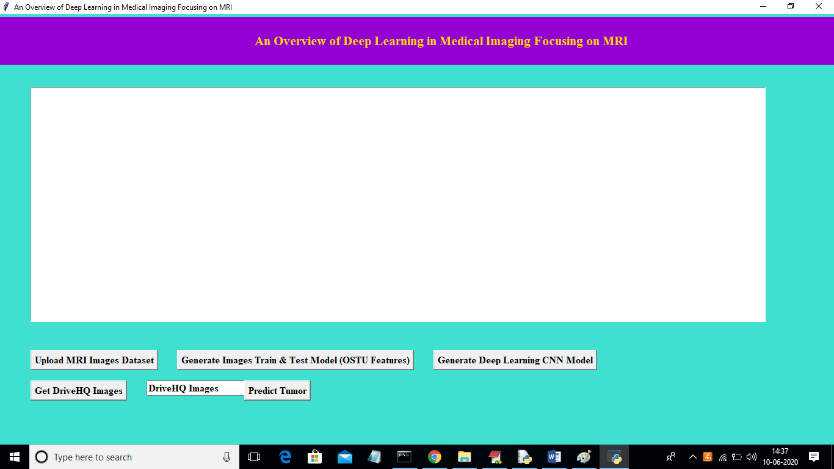
Home Page

Slide 16
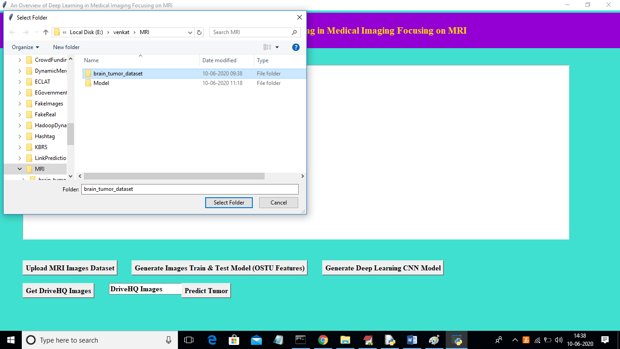
Upload Dataset

Slide 17
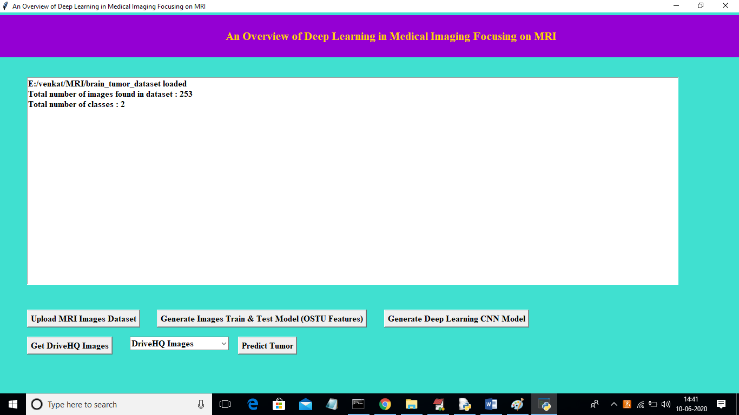
Generate Train and Test Model

Slide 18
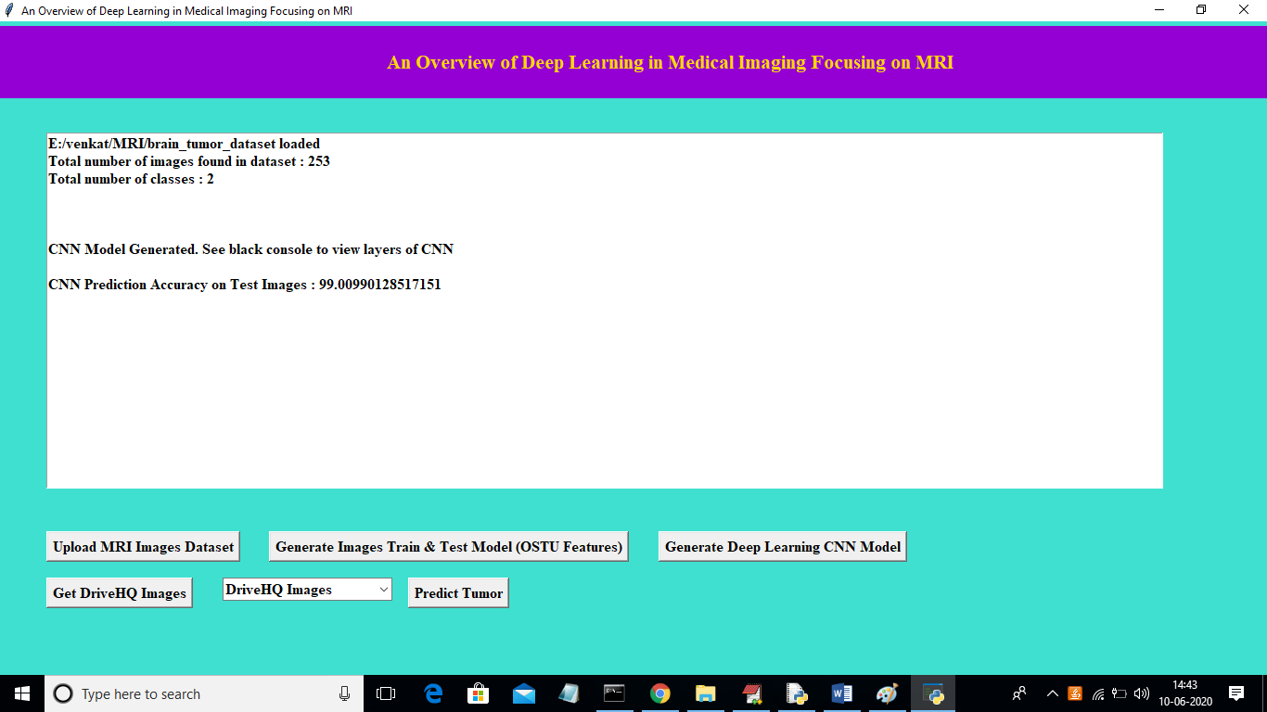
Run Deep learning Algorithm

Slide 19
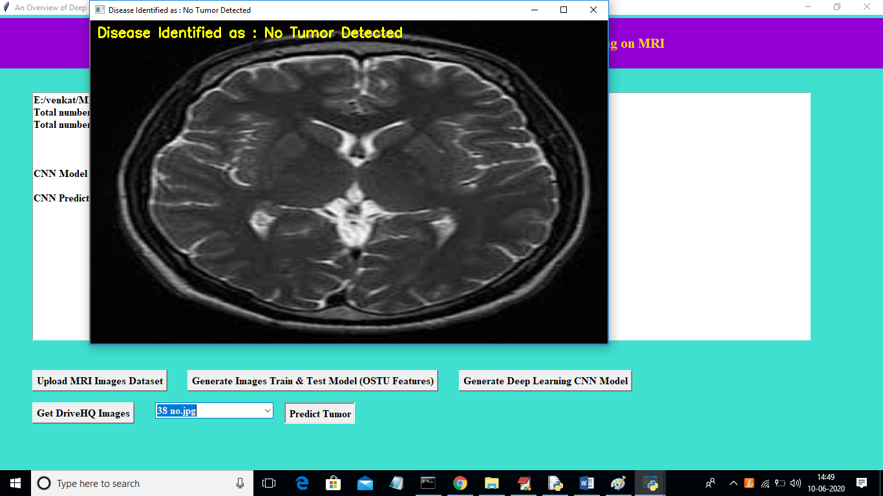
Predict

Slide 20
CONCLUSION
Arecurring theme in machine learning is the limit imposed by the lack of labelled datasets, which hampers training and task performance. Conversely, it is acknowledged that more data improves performance, as Sun et al. shows using an internal Google dataset of 300 million images. In general computer vision tasks, attempts have been made to circumvent limited data by using smaller lters on deeper layers , with novel CNN architecture combinations , or hyperparameter optimization

Slide 21
REFERENCES
[1] C.-J. Hsiao, E. Hing, and J. Ashman, ``Trends in electronic health record system use among ofce-based physicians: United states, 20072012,'' Nat. Health Stat. Rep., vol. 75, pp. 118, May 2014.
[2] R. Smith-Bindman et al., ``Use of diagnostic imaging studies and associated radiation exposure for patients enrolled in large integrated health care systems, 19962010,'' JAMA, vol. 307, no. 22, pp. 24002409, 2012.
[3] E. H. Shortliffe, Computer-Based Medical Consultations: MYCIN, vol. 2. New York, NY, USA: Elsevier, 1976.

